Slide 1
Iso-Kinetic Sampling Training Course
Dr Roger S Brown
Oakwood Environmental Services
Tel: 020 8844 0914
Fax: 020 8384 0767
Mob: 077 99 62 3891
Email: r s.brown@oakwood-environmental.co.uk
Web: www.oakwood-environmental.co.uk

Slide 2
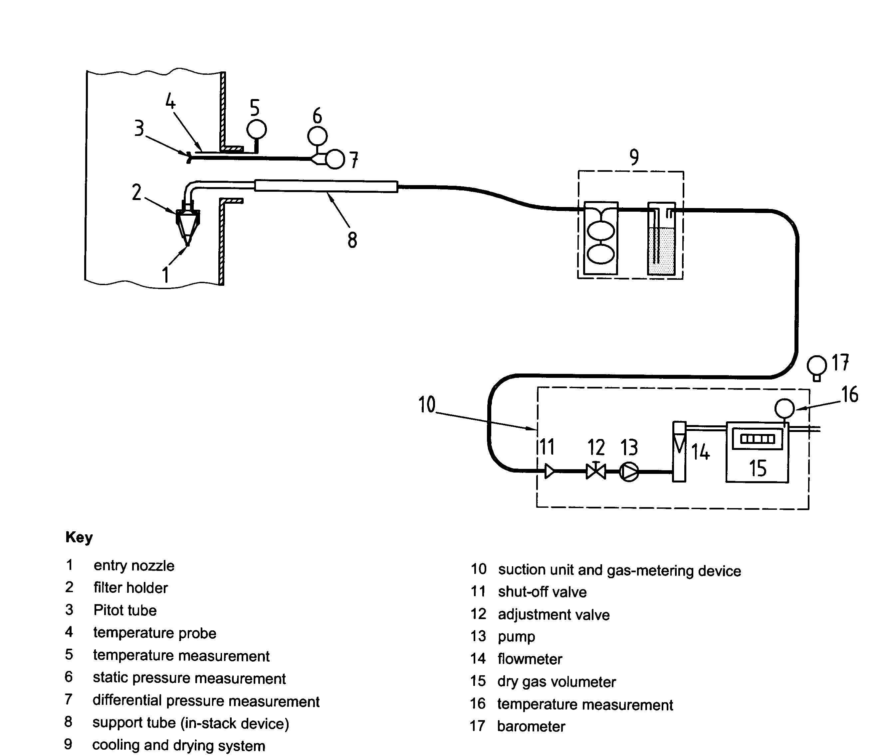
M9096 Type Stack Train

Slide 3
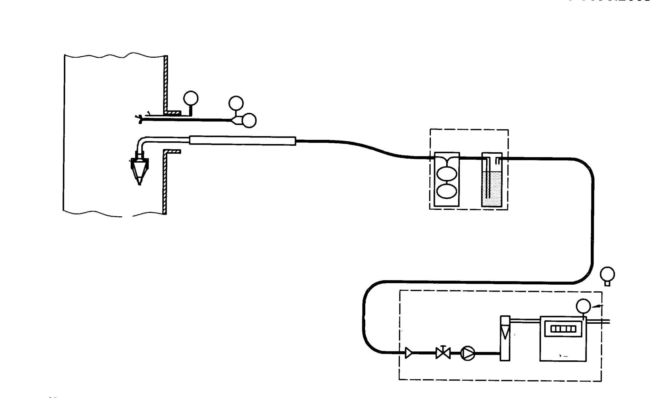
Relationship of flow at Gas Meter and Stack Velocity
Wet Gas
Ps
Ts
Δp
Vn
Vs
Tm
Dry Gas
Qm
Adjust Flow Qm Here to match flow required at nozzle
Pm

Slide 4
How is Sampling Rate Set
Select a Nozzle which is within the flow rate achievble by the Pump
Calculate the flow rate required through the size of nozzle selected such that Vn = VS taking into account the temperature of the gas meter and flow meter and the temperature of the stack.
Use a Spread Sheet on a computer
Use a nomograph Slide Rule
Use a programmed Calculator

Slide 5
Pre Test – Assessment of Conditions
In order to perform Particulate Testing to EN13284-1 using a US EPA Method 5 type train it is necessary to effectively conduct 5 stages of pre-assessment;
Select location and check suitability
Conduct a velocity traverse of the duct
Chose no of sample positions
Determine Molecular weight of flue gases/density
Determine moisture of flue gases

Slide 6
Pre Test – Choosing a Location (often preset)
Select a suitable sampling position and this needs to take into account the length of straight duct available, dampers, bends exit point etc. The EU states 5 downstream and 2 upstream
Normally this will then lead to 4 to 20 points per plane split between the number of traverses to be used, usually 2 on a circular duct.

Slide 7
BS13284:2002 Sample Points for Circular Ducts
Range of sampling plane areas | Range of duct diameters | Minimum number of sampling lines (diameters) | Minimum sampling points per plane
m² | m
<0.1 | <0.35 | - | 1 ^{(a)}
0.1 - 1.0 | 0.35 - 1.1 | 2 | 4
1.1 - 2.0 | 1.1 - 1.6 | 2 | 8
>2.0 | >1.6 | 2 | At least 12 and 4 per m^{2 (b)}
a) Using only one sample point may give rise to errors greater than those specified in this standard b) For large ducts a number of 20 sampling points is generally sufficient

Slide 8
BS9096:2003 Sample Points for Circular Ducts
Range of sampling plane areas | Range of duct diameters | Minimum number of sampling lines (diameters) | Minimum sampling points per plane
m² | m
<0.1 | <0.35 | - | 1 ^{(a)}
0.1 – 0.38 | 0.35 – 0.70 | 2 | 4
0.38 – 0.79 | 0.70 – 1.00 | 2 | 8
0.79-3.1 | 1.00-2.00 | 2 | 12
>3.1 | >2.00 | 2 | 16
a) Using only one sample point may give rise to errors greater than those specified in this standard

Slide 9
Selection of Minimum Traverse Points for EU Standards and Tangential Rule

Slide 10
Selection of Minimum Traverse Points for EU Standards and Tangential Rule

Slide 11
Sample Positions and Wall Effects
Sample Points shall not be located within 3% of the sampling line length if d>1.5m or <5cm if d<1.5m from the inner duct wall.
Were this occurs move that point to the edge of the no go area.

Slide 12
Sample Positions and Wall Effects
If d< 3% of D or <5cm depending on size of D move the point to either 5cm from wall or to 3% of D
d
D

Slide 13
Velocity Traverse of Stack To Determine Nozzle Size and homogeneity of flow conditions at the selected sample position
Determine the velocity in the duct using an S-type Pitot tube or L-type tube
Visually check pitot tube
Leak check the pitot assembly
Record barometric pressure
Mark pitot tube with the number of traverse points to be used
Insert the pitot tube carefully into duct and record pressure and temperature at each point
Check for cyclonic flow
Measure static pressure in duct

Slide 14
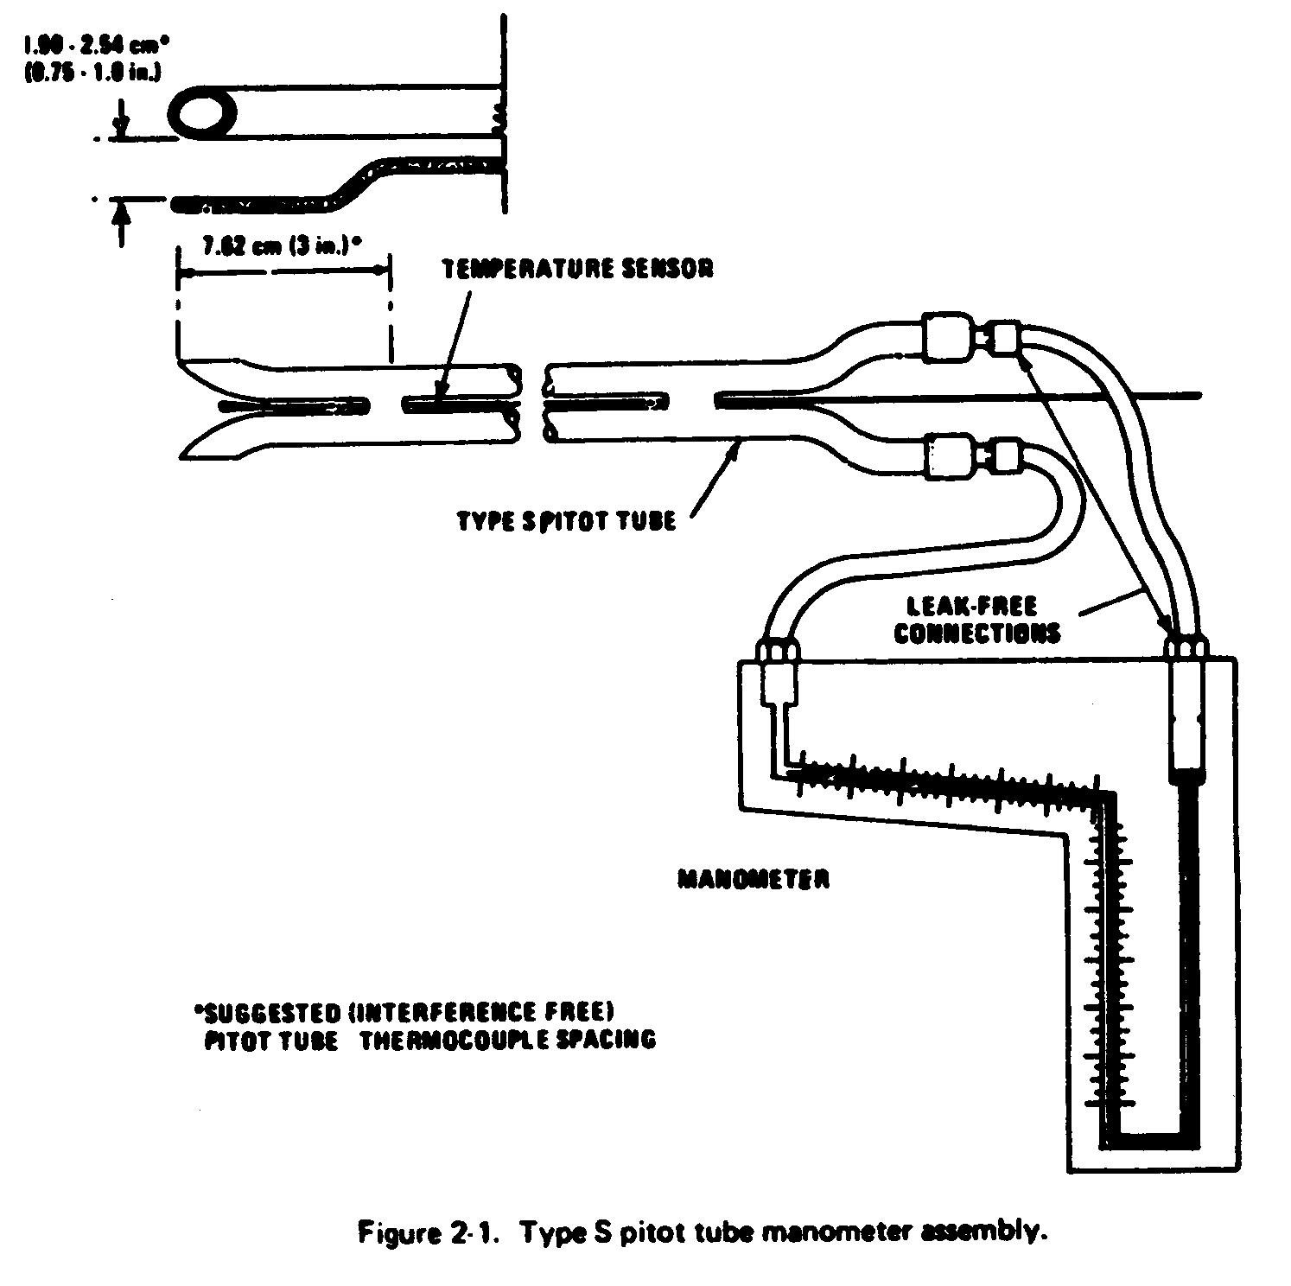
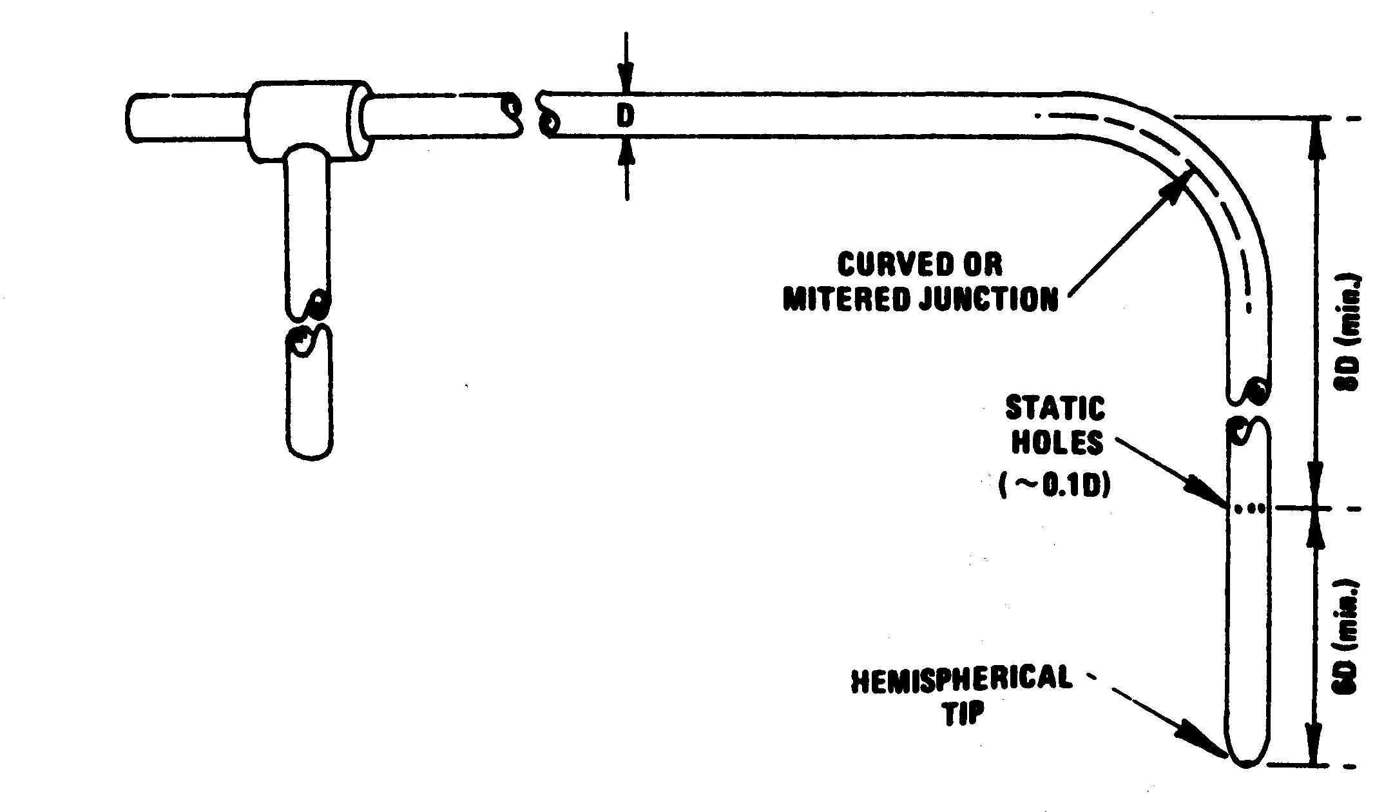
Pitot Tubes

Slide 15
Position of Sampling Ports/Location
Flow within many ducts is Turbulent great for gases bad for Particulate sampling
The Best location must be sought where the flow is axial to the nozzle at the point of sampling within ±15º of the flow of the gas stream
The velocity should be relatively Uniform across the duct the ratio of highest to lowest gas velocities must be less than 3:1 (Equates to pressure 9:1)
Minimum velocity for pitot tubes is 5Pa (0.51 mmH₂0)
No negative flow present

Slide 16
If Criteria are not Met
The sample location does not conform with BS9096
Choose another location, or if not possible increase number of sample points.
Record deviations

Slide 17
Molecular Weight Determination
Using what ever means to determine major constituents of flue gas CO₂, O₂, CO by difference calculate N₂
N₂= 100-(%O₂+%CO₂+%CO)
Calculate dry molecular weight of gases
M_{d}=0.44(%CO₂)+0.32(%O₂)+0.28(%N₂+%CO)

Slide 18
Determine Water Vapour in Stack
Use US EPA Method 4/BS EN 14790 or calculate moisture present in the emission gases if this is possible.
Moisture tests can be combined with BS ISO 9096 or BS EN13284 tests and moisture levels determined
Collect water vapour in a series of weighed impingers filled with water inserted in a cold bath. Or using silica gel in the handle of the probe.
Calculate the amount of water collected and calculate the water vapour fraction present in the gases Bws
Now Calculate Stack gas molecular wt
Ms=0.18(%H₂O)+M_{d}(100-%H₂O)/100

Slide 19
Select Nozzle Size
Select Nozzle size from the velocity traverse ensuring that the nozzle size is >4mm in diameter
The above must have due regard for the maximum pump capacity of the sample equipment.

Slide 20
Nozzle Calculations
D_{n} =
Constant = 0.6071
Qm: ideal meter flow rate for system
Cp: Pitot Tube Coefficient
Temperature of Meter
Bws: Moisture Content of stack as a fraction i.e 6% is 0.06
Bwm :Moisture Content of Meter (usually zero)
Ms: Molecular Weight of the Stack Gases including moisture
Ps & Pm: Pressure in the Stack and Meter respectively
ΔP The differential pressures arising from the velocity of gases
Ts & Tm: Temperature of the stack and meter respectively

Slide 21

Leak Check M9096 Type Stack Train
flow meter should drop to zero
Apply Maximum Pump rate
Q_{l<2%}

Slide 22
Filter Media Preparation
In Stack filtration is easier than out of stack filtration in general
BS ISO 9096 High Dust Standard differs from BS EN 13284-1 mainly in the precision of the weighing and preparation methods.
Ideally filter is Quartz, minimises artefact formation (reactions on filter media)
Plane filter efficiency is 99.5% on a test aerosol with a size of 0.3μ at the flow rates expected
Check reagent purity water and acetone (<10mg/l dry residue)

Slide 23
Filter Preparation
Check balance with calibrated weights
Use control components
Record Climatic conditions of weighing room (temp, barometric pressure etc as this affects large components)
Electrostatic charges are a problem with very low levels use an ion gun
Pre-condition filters and weighed components to 180ºC for at least an hour and for the same time each time, cool in the same way using a dessicator (min 8 hours)
It may be useful as in BS EN 13284-1 to weigh at 1min, 2min and 3 min and extrapolate back to zero. The filter may need to be re-conditioned where large increases or instability is noted.

Slide 24
Sampling to BS9096
Having completed pre-assessment, chosen the nozzle size required for the equipment and select an initial sample rate.
Using a Pre-dried a filter with a 99.5% efficiency on a 0.3μ aerosol test and weighed to constant weight at 180ºC as discussed
Assemble the equipment having cleaned it with decon 90 or similar and rinse with de-ionised water and analar acetone
Attach the appropriate nozzle size having checked for damage and measured it
Conduct a leak check at maximum including the probe and nozzle

Slide 25
Blank Test
Find any leaks >2% of flow rate to be used and correct
Pre-heat the equipment to minimise condensation
Conduct a blank test- insert probe into the stack and ensure nozzle is facing downstream ( i.e the wrong way) (Leave in stack for 15 minutes for BS ISO 9096) do not switch on pump.
Recover the sample, wash upstream of filter with 2 washes water and 1 wash of acetone

Slide 26
Conducting Actual Test
Re assemble equipment, conduct a leak test
Insert the probe and seal the sample port
Set the isokinetic rate using a nomograph or slide rule or calculator, record the gas meter reading, start the pump,, set the flowrate and record all the sampling parameters on a sample form every 5 minutes.
Sample at equal times at each sample point do not change nozzle
When each line is completed, stop the pump, if any disassembly is required re-leak check the equipment and re-inset on the next sample line.
Sample time is a minimum of 30 min but determined by the weighing procedure
Finally conduct leak check

Slide 27
Conducting Actual Test
Do not stop the pump between points on a line
If any component needs to be changed then a leak check should be conducted
When moving to another traverse line a leak check should be conducted and the pump stopped during the change over
When satisfactory start sampling again
At the end of the sampling period stop the pump record final gas meter reading
Conduct a post leak check

Slide 28
Sample Recovery of Deposits
Recover Filter in a dust free environment. For Post Conditioning
Recover Deposits from nozzle if there are no bends between the nozzle and the filter, this can be ignored provided the gases are unsaturated, above the dew-point and if a validation has been conducted to ensure deposits are <10% of the average limit value.
Rinse internal surfaces of nozzle with 2 x water followed by 1x acetone and collect in the same bottle.
Evaporate washings and dry off in an oven at 160ºC for 1hr

Slide 29
Post Sampling Conditioning
Re-dry filter and weighed components at 160ºC for minimum of 1 hour be reproducible, equilibrate in a dessicator minimum of 4 hours
Weigh at 1min, 2min and 3 min and extrapolate back to zero. The filter may need to be re-conditioned where large increases or instability is noted.

Slide 30
Step by Step Process of Conducting Test
Measure Duct & Identify Sample Position
Determine No of Sample Positions & Traverses
Conduct Initial Velocity Traverse Check for Cyclonic flow
Determine Molecular Weight/Density of Gases
Determine Moisture of gases
Prepare Sample Equipment, filter, Select Nozzle Size
Conduct Leak Check and Blank Sample Recover
Conduct Leak Check and Conduct Isokinetic Test
Conduct Post Sampling Leak Check and Recover Sample.

Slide 31
Sample and Blank Recovery
Recover Filter
Rinse all upstream components of filter with water x 2 and Acetone x 1
Dry Filter at 160ºC minimum of 1 hrs
Evaporate Washings and dry in oven at 160ºC
Weigh Filters
Calculate Particulate Level and Correct to appropriate reference Oxygen level for the period of test

